Slide 1
Introduction
Databases systems [BS-IV(CS/SE)] [Spring 2023]
Dr. Muhammad Hussain Mughal
Muhammad.hussain@iba-suk.edu.pk
Most of the content was taken from slides of book “Database System Concepts, 7th Ed, Silberschatz, Korth and Sudarshan”

Slide 2
Course Assessment
Assessment | Weightage
Mid Exams | 30
Quiz | 10
Class Participation/Assignment | 10
Final Exam | 50

Slide 3
Office Hours and contact details
Cubical #05, Block-I
Email: Muhammad.Hussain@iba-suk.edu.pk

Slide 4
What comes to your mind ……
…… when you think about “Databases”

Slide 5
What is Database
a structured set of data held in a computer, especially one that is accessible in various ways. [google]
an organized body of related information. [Oxford Dictionary]
a large amount of information stored in a computer system in such a way that it can be easily looked at or changed. [Cambridge Dictionary]
a usually large collection of data organized especially for rapid search and retrieval (as by a computer). [merriam-webster]
Shared collection of logically related data (and a description of this data), designed to meet the information needs of an organization. [Thomas Connolly]

Slide 6
What is Database
A structured set of logically related data (and a description of this data), designed and stored in a way that it can easily be searched, retrieved and/or changed

Slide 7
Database (Management) System
DBMS contains information about a particular enterprise
Collection of interrelated data
Set of programs to access the data
An environment that is both convenient and efficient to use
A modern database system is a complex software system whose task is to manage a large, complex collection of data
Notes:
A database-management system (DBMS) is a collection of interrelated data and a set of programs to access those data. The collection of data, usually referred to as the database, contains information relevant to an enterprise. The primary goal of a DBMS is to provide a way to store and retrieve database information that is both convenient and efficient.
Database systems are designed to manage large bodies of information. Management of data involves both defining structures for storage of information and providing mechanisms for the manipulation of information

Slide 8
Current Market
Relational DBMSs still anchor the software industry
Elephants: Oracle, Microsoft, IBM, Teradata, HP, …
Open source: MySQL, PostgreSQL
Emerging Variants: In-Memory, Column-oriented
Open Source “NoSQL” is growing
Analytics: Hadoop MapReduce, Spark
Key-value stores: Cassandra, Mongo, CouchDB, …
Search SW is an important special case
Google & Bing, Solr, Lucene
Cloud services are expanding quickly
Amazon Redshift/ElasticSearch/EMR, MS Azure, Heroku, …

Slide 9
Database Applications
Databases touch all aspects of our lives
Enterprise Information
Sales: customers, products, purchases
Accounting: payments, receipts, assets
Human Resources: Information about employees, salaries, payroll taxes.
Manufacturing: management of production, inventory, orders, supply chain.
Banking and finance
customer information, accounts, loans, and banking transactions.
Credit card transactions
Finance: sales and purchases of financial instruments (e.g., stocks and bonds; storing real-time market data
Universities: registration, grades
Notes:
Earlier applications were relatively simple compared to modern database applications. Modern applications include highly sophisticated, worldwide enterprises.
All database applications, old and new, share important common elements. The central aspect of the application is not a program performing some calculation, but rather the data themselves.
Today, database applications may include data with complex relationships and a
more variable structure. As an example of an application with structured data, consider
a university’s records regarding courses, students, and course registration. The university
keeps the same type of information about each course: course-identifier, title, department,
course number, etc., and similarly for students: student-identifier, name, address,
phone, etc. Course registration is a collection of pairs: one course identifier and
one student identifier.
Here are some examples of database applications applications:
• Enterprise Information
° Sales: For customer, product, and purchase information.
° Accounting: For payments, receipts, account balances, assets, and other accounting
information.
° Human resources: For information about employees, salaries, payroll taxes, and
benefits, and for generation of paychecks.
• Manufacturing: For management of the supply chain and for tracking production
of items in factories, inventories of items in warehouses and stores, and orders for
items.
• Banking and Finance
° Banking: For customer information, accounts, loans, and banking transactions.
° Credit card transactions: For purchases on credit cards and generation of
monthly statements.
° Finance: For storing information about holdings, sales, and purchases of financial
instruments such as stocks and bonds; also for storing real-time market
data to enable online trading by customers and automated trading by the firm.
• Universities: For student information, course registrations, and grades (in addition
to standard enterprise information such as human resources and accounting).
• Airlines: For reservations and schedule information. Airlines were among the first
to use databases in a geographically distributed manner.
• Telecommunication: For keeping records of calls, texts, and data usage, generating
monthly bills, maintaining balances on prepaid calling cards, and storing information
about the communication networks.
• Web-based services
° Social-media: For keeping records of users, connections between users (such as
friend/follows information), posts made by users, rating/like information about
posts, etc.
° Online retailers: For keeping records of sales data and orders as for any retailer,
but also for tracking a user’s product views, search terms, etc., for the purpose
of identifying the best items to recommend to that user.
° Online advertisements: For keeping records of click history to enable targeted
advertisements, product suggestions, news articles, etc. People access such
databases every time they do a web search, make an online purchase, or access
a social-networking site.
• Document databases: For maintaining collections of new articles, patents, published
research papers, etc.
• Navigation systems: Formaintaining the locations of varies places of interest along
with the exact routes of roads, train systems, buses, etc.

Slide 10
Database Applications
Databases touch all aspects of our lives
Airlines: reservations, schedules
Telecommunication: records of calls, texts, and data usage, generating monthly bills, maintaining balances on prepaid calling cards
Web-based services
Online retailers: order tracking, customized recommendations
Online advertisements
Document databases
Navigation systems: For maintaining the locations of varies places of interest along with the exact routes of roads, train systems, buses, etc.

Slide 11
Purpose of Database Systems File System Vs Database System
In the early days, database applications were built directly on top of file systems, which leads to:
Data redundancy and inconsistency: data is stored in multiple file formats resulting in duplication of information in different files
Difficulty in accessing data
Need to write a new program to carry out each new task
Data isolation
Multiple files and formats
Integrity problems
Integrity constraints (e.g., account balance > 0) become “buried” in program code rather than being stated explicitly
Hard to add new constraints or change existing ones
Notes:
In order to understand this topic further, please read page number 6,7,8 of book - Avi Silberschatz: "Database System Concepts”

Slide 12

Purpose of Database Systems File System Vs Database System
In the early days, database applications were built directly on top of file systems, which leads to:
Atomicity of updates
Failures may leave database in an inconsistent state with partial updates carried out
Example: Transfer of funds from one account to another should either complete or not happen at all
Concurrent access by multiple users
Concurrent access needed for performance
Uncontrolled concurrent accesses can lead to inconsistencies
Ex: Two people reading a balance (say 100) and updating it by withdrawing money (say 50 each) at the same time
Security problems
Hard to provide user access to some, but not all, data
So, the purpose of Database System is to solve these problems.

Slide 13
Data Model: Description of Data
A collection of tools for describing
Data
Data relationships
Data semantics
Data constraints
Relational model
Entity-Relationship data model (mainly for database design)
Object-based data models (Object-oriented and Object-relational)
Semi-structured data model (XML)
Other older models:
Network model
Hierarchical model
Notes:
A database system is a collection of interrelated data and a set of programs that allow
users to access and modify these data. A major purpose of a database system is to
provide users with an abstract view of the data. That is, the system hides certain details
of how the data are stored and maintained.
Data Model:
Underlying the structure of a database is the data model: a collection of conceptual tools for describing data, data relationships, data semantics, and consistency constraints. There are a number of different data models that we shall cover in the text. The data models can be classified into four different categories:
RelationalModel:- The relational model uses a collection of tables to represent both data and the relationships among those data. Each table has multiple columns, and each column has a unique name. Tables are also known as relations. The relational model is an example of a record-based model
Entity-Relationship Model:- The entity-relationship (E-R) data model uses a collection of basic objects, called entities, and relationships among these objects. An entity is a “thing” or “object” in the real world that is distinguishable from other
objects. The entity-relationship model is widely used in database design
Semi-structured Data Model:- The semi-structured data model permits the specification of data where individual data items of the same type may have different sets of attributes. This is in contrast to the data models mentioned earlier, where
every data item of a particular type must have the same set of attributes. JSON and Extensible Markup Language (XML) are widely used semi-structured data representations.
Object-Based Data Model:- Object-oriented programming (especially in Java, C++, or C#) has become the dominant software-development methodology. This led initially to the development of a distinct object-oriented data model, but today the concept of objects is well integrated into relational databases. Standards exist to store objects in relational tables. Database systems allow procedures to be stored in the database system and executed by the database system

Slide 14
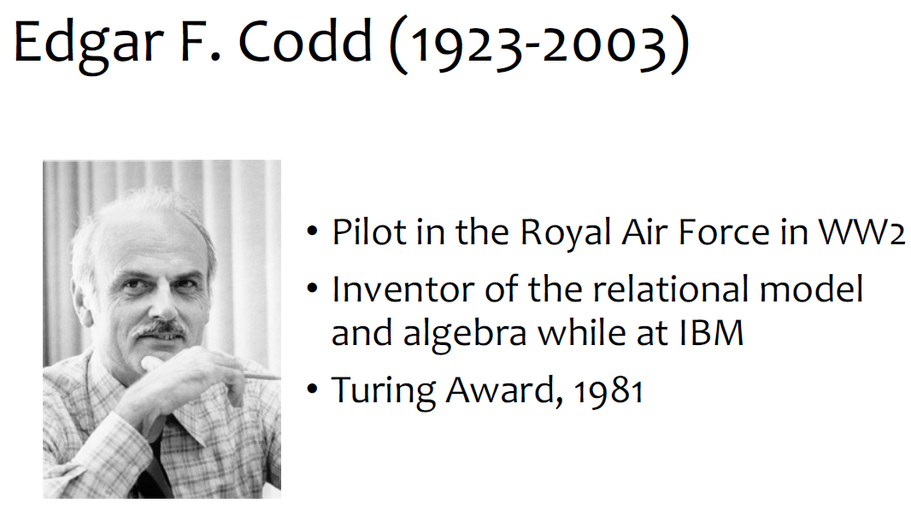
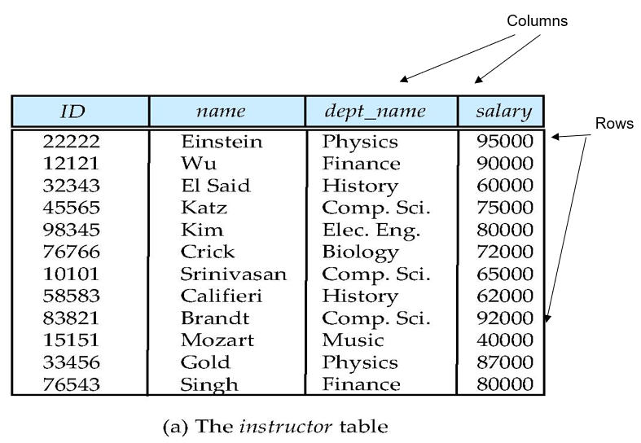
Relational Model
- Database is a collection of Relations (or Tables)
- Each relation has a set of attributes (or Columns)
- Each attribute has a name and a domain (or Type)
- Atomic Values (no Set-valued attribute)
- Each relation contains a set of tuples (or rows)
- Each tuple has value for each attribute of the relation
- No duplicate tuples
- Two tuples are duplicates if they agree on all attributes
Simplicity is the power of this model
Notes:
Relational Data Model:- In the relational model, data are represented in the form of tables. Each table has multiple columns, and each column has a unique name. Each row of the table represents
one piece of information. Figure 1.1 presents a sample relational database comprising two tables: one shows details of university instructors and the other shows details of the various university departments.
The first table, the instructor table, shows, for example, that an instructor named Einstein with ID 22222 is a member of the Physics department and has an annual salary of $95,000. The second table, department, shows, for example, that the Biology department is located in the Watson building and has a budget of $90,000. Of course, a real-world university would have many more departments and instructors.

Slide 15
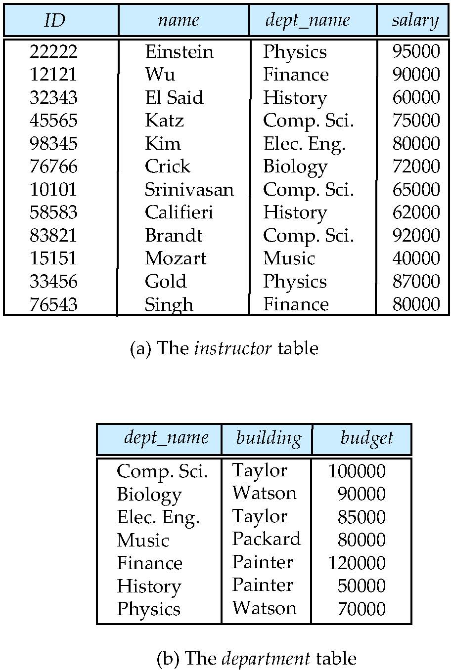
A Sample Relational Database

Slide 16
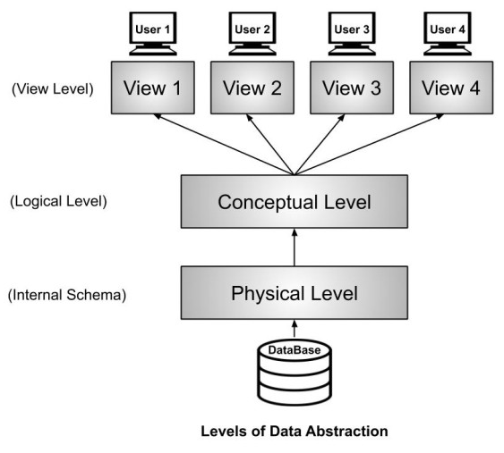
Data Abstraction [Levels of Abstraction]
Physical level: describes how a record (e.g., instructor) is stored.
Logical level: describes data stored in database, and the relationships among the data.
View level: application programs hide details of data types. Views can also hide information (such as an employee’s salary) for security purposes.
Notes:
Data Abstraction:- For the system to be usable, it must retrieve data efficiently. The need for efficiency has led database system developers to use complex data structures to represent data in the database. Since many database-system users are not computer trained, developers hide the complexity from users through several levels of data abstraction, to simplify users’ interactions with the system:
• Physical level:- The lowest level of abstraction describes how the data are actually stored. The physical level describes complex low-level data structures in detail.
• Logical level:- The next-higher level of abstraction describes what data are stored in the database, and what relationships exist among those data. The logical level thus describes the entire database in terms of a small number of relatively simple structures. Although implementation of the simple structures at the logical level may involve complex physical-level structures, the user of the logical level does not need to be aware of this complexity. This is referred to as physical data independence. Database administrators, who must decide what information to keep in the database, use the logical level of abstraction.
• View level: The highest level of abstraction describes only part of the entire database. Even though the logical level uses simpler structures, complexity remains because of the variety of information stored in a large database. Many users of the
database system do not need all this information; instead, they need to access only a part of the database. The view level of abstraction exists to simplify their interaction with the system. The system may provide many views for the same database.

Slide 17
Instances (data) and Schemas (metadata)
Logical Schema – the overall logical structure of the database
defined at setup time
Rarely changes
Analogous to type information of a variable in a program
Physical schema – the overall physical structure of the database
Instance – the actual content of the database at a particular point in time
Analogous to the value of a variable
Represents the data content
Changes rapidly, but always conforms to the schema
Compare to types vs. collections of objects of these types in a programming language
Notes:
Databases change over time as information is inserted and deleted. The collection of information stored in the database at a particular moment is called an instance of the database. The overall design of the database is called the database schema. The concept of database schemas and instances can be understood by analogy to a program written in a programming language. A database schema corresponds to the variable declarations (along with associated type definitions) in a program. Each variable has a particular value at a given instant. The values of the variables in a program at a point in time correspond to an instance of a database schema.
Database systems have several schemas, partitioned according to the levels of abstraction. The physical schema describes the database design at the physical level, while the logical schema describes the database design at the logical level

Slide 18
Instances (data) and Schemas (metadata)
Example
Schema
User (uid int, name string, age int, pop float)
Group (gid string, name string)
Member (uid int, gid string)
Instance
User: {〈142, Bart, 10, 0.9〉,〈857, Milhouse, 10, 0.2〉, ...}
Group: {〈abc, Book Club〉,〈gov, Government〉, ...}
Member: {〈142,gov 〉, 〈123, gov〉, ...}
Notes:
Point of presence
Databases change over time as information is inserted and deleted. The collection of information stored in the database at a particular moment is called an instance of the database. The overall design of the database is called the database schema. The concept of database schemas and instances can be understood by analogy to a program written in a programming language. A database schema corresponds to the variable declarations (along with associated type definitions) in a program. Each variable has a particular value at a given instant. The values of the variables in a program at a point in time correspond to an instance of a database schema.
Database systems have several schemas, partitioned according to the levels of abstraction. The physical schema describes the database design at the physical level, while the logical schema describes the database design at the logical level

Slide 19
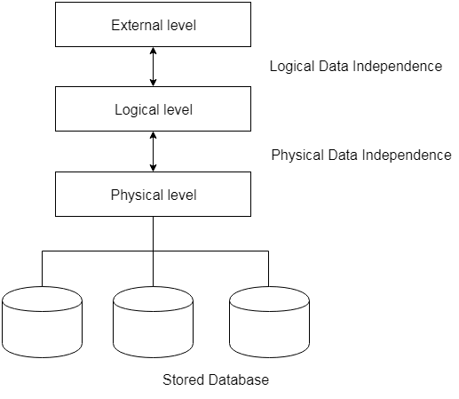
Data Independence
Physical Data Independence – the ability to modify the physical schema without affecting / changing the logical schema
Logical Data Independence – the ability to modify the logical schema without affecting / changing the conceptual / view level schema
Applications depend on the logical schema
In general, the interfaces between the various levels and components should be well defined so that changes in some parts do not seriously influence others
Notes:
Physical Data Independence
Physical data independence helps you to separate conceptual levels from the internal/physical levels. It allows you to provide a logical description of the database without the need to specify physical structures. Compared to
Logical Independence, it is easy to achieve physical data independence.
With Physical independence, you can easily change the physical storage structures or devices with an effect on the conceptual schema. Any change done would be absorbed by the mapping between the conceptual and internal levels. Physical data independence is achieved by the presence of the internal level of the database and then the transformation from the conceptual level of the database to the internal level.
Examples of changes under Physical Data Independence
Due to Physical independence, any of the below change will not affect the conceptual layer.
Using a new storage device like Hard Drive or Magnetic Tapes
Modifying the file organization technique in the Database
Switching to different data structures.
Changing the access method.
Modifying indexes.
Changes to compression techniques or hashing algorithms.
Change of Location of Database from say C drive to D Drive
Logical Data Independence
Logical Data Independence is the ability to change the conceptual scheme without changing
External views
External API or programs
Any change made will be absorbed by the mapping between external and conceptual levels.
When compared to Physical Data independence, it is challenging to achieve logical data independence.
Examples of changes under Logical Data Independence
Due to Logical independence, any of the below change will not affect the external layer.
Add/Modify/Delete a new attribute, entity or relationship is possible without a rewrite of existing application programs
Merging two records into one
Breaking an existing record into two or more records

Slide 20
Database Languages
Data Definition Language (DDL)
Specification notation for defining the database schema
DDL compiler generates a set of table templates stored in a data dictionary
Data dictionary contains metadata (i.e., data about data)
Database schema
Integrity constraints
Primary key (ID uniquely identifies instructors)
Authorization
Who can access what
Example: create table instructor ( ID char(5), name varchar(20), dept_name varchar(20), salary numeric(8,2))
Notes:
Database Languages
A database system provides a data-definition language (DDL) to specify the database schema and a data-manipulation language (DML) to express database queries and up- dates. In practice, the data-definition and data-manipulation languages are not two separate languages; instead they simply form parts of a single database language, such as the SQL language. Almost all relational database systems employ the SQL language
Data-Definition Language
We specify a database schema by a set of definitions expressed by a special language called a data-definition language (DDL). The DDL is also used to specify additional properties of the data.
We specify the storage structure and access methods used by the database system by a set of statements in a special type of DDL called a data storage and definition language. These statements define the implementation details of the database schemas, which are usually hidden from the users
Data-Manipulation Language
A data-manipulation language (DML) is a language that enables users to access or manipulate data as organized by the appropriate data model. The types of access are:
• Retrieval of information stored in the database. • Insertion of new information into the database. • Deletion of information from the database. • Modification of information stored in the database.
There are basically two types of data-manipulation language:
• Procedural DMLs require a user to specify what data are needed and how to get those data.
• Declarative DMLs (also referred to as nonprocedural DMLs) require a user to specify what data are needed without specifying how to get those data.
Declarative DMLs are usually easier to learn and use than are procedural DMLs. However, since a user does not have to specify how to get the data, the database system has to figure out an efficient means of accessing data.
A query is a statement requesting the retrieval of information. The portion of a DML that involves information retrieval is called a query language. Although technically incorrect, it is common practice to use the terms query language and data-manipulation language synonymously.

Slide 21
Database Languages
Data Manipulation Language (DML)
Language for accessing and updating the data organized by the appropriate data model
DML also known as query language
Two classes of languages
Pure – used for proving properties about computational power and for optimization
Relational Algebra
Tuple relational calculus
Domain relational calculus
Commercial – used in commercial systems
SQL is the most widely used commercial language
Example: Update instructor set salary = 50000 where ID=2345

Slide 22
Database Languages
Data Manipulation Language (DML)
There are basically two types of data-manipulation language
Procedural DML -- require a user to specify what data are needed and how to get those data.
Declarative DML -- require a user to specify what data are needed without specifying how to get those data.
Declarative DMLs are usually easier to learn and use than procedural DMLs.
Declarative DMLs are also referred to as non-procedural DMLs
The portion of a DML that involves information retrieval is called a query language.

Slide 23
Database Access from Application Program
SQL does not support actions such as input from users, output to displays, or communication over the network.
Such computations and actions must be written in a host language, such as C/C++, Java or Python, with embedded SQL queries that access the data in the database.
Application programs -- are programs that are used to interact with the database in this fashion.
Notes:
Database Access from Application Programs
Non-procedural query languages such as SQL are not as powerful as a universal Turing machine; that is, there are some computations that are possible using a general-purpose programming language but are not possible using SQL. SQL also does not support ac- tions such as input from users, output to displays, or communication over the network. Such computations and actions must be written in a host language, such as C/C++, Java, or Python, with embedded SQL queries that access the data in the database. Application programs are programs that are used to interact with the database in this fashion. Examples in a university system are programs that allow students to register for courses, generate class rosters, calculate student GPA, generate payroll checks, and perform other tasks.

Slide 24
Database Design
Conceptual Data Model:
-defines WHAT the system contains
-typically created by Business stakeholders and Data
Architects
- Purpose: organize, scope and define business concepts and rules.
Logical Data Model:
Defines HOW the system should be implemented
regardless of the DBMS
typically created by Data Architects and Business Analysts
Purpose: develop technical map of rules and data structures.
Physical Data Model:
describes HOW the system will be implemented using a specific DBMS system
typically created by DBA and developers
Purpose: actual implementation of the database.
Notes:
The initial phase of database design, then, is to characterize fully the data needs of the prospective database users. The database designer needs to interact extensively with domain experts and users to carry out this task. The outcome of this phase is a specification of user requirements.
Next, the designer chooses a data model, and by applying the concepts of the chosen data model, translates these requirements into a conceptual schema of the database. The schema developed at this conceptual-design phase provides a detailed overview of the enterprise. The designer reviews the schema to confirm that all data requirements are indeed satisfied and are not in conflict with one another. The designer can also examine the design to remove any redundant features. The focus at this point is on describing the data and their relationships, rather than on specifying physical storage details.
In terms of the relational model, the conceptual-design process involves decisions on what attributes we want to capture in the database and how to group these attributes to form the various tables. The “what” part is basically a business decision, and we shall not discuss it further in this text. The “how” part is mainly a computer-science problem. There are principally two ways to tackle the problem.
The process of moving from an abstract data model to the implementation of the database proceeds in two final design phases. In the logical-design phase, the de- signer maps the high-level conceptual schema onto the implementation data model of the database system that will be used. The designer uses the resulting system-specific database schema in the subsequent physical-design phase, in which the physical features of the database are specified.
Types of Data Models
Types of Data Models: There are mainly three different types of data models: conceptual data models, logical data models, and physical data models, and each one has a specific purpose. The data models are used to represent the data and how it is stored in the database and to set the relationship between data items.
Conceptual Data Model: This Data Model defines WHAT the system contains. This model is typically created by Business stakeholders and Data Architects. The purpose is to organize, scope and define business concepts and rules.
Logical Data Model: Defines HOW the system should be implemented regardless of the DBMS. This model is typically created by Data Architects and Business Analysts. The purpose is to developed technical map of rules and data structures.
Physical Data Model: This Data Model describes HOW the system will be implemented using a specific DBMS system. This model is typically created by DBA and developers. The purpose is actual implementation of the database.

Slide 25
Database Internals: Database Engine
A database system is partitioned into modules that deal with each of the responsibilities of the overall system.
The functional components of a database system can be divided into
The storage manager,
The query processor component,
The transaction management component.
Notes:
Database Engine
A database system is partitioned into modules that deal with each of the responsibilities of the overall system. The functional components of a database system can be broadly divided into the storage manager, the query processor components, and the transaction management component.
The storage manager is important because databases typically require a large amount of storage space. Corporate databases commonly range in size from hundreds of gigabytes to terabytes of data
Since the main memory of computers cannot store this much information, and since the contents of main memory are lost in a system crash, the information is stored on disks. Data are moved between disk storage and main memory as needed. Since the movement of data to and from disk is slow relative to the speed of the central processing unit, it is imperative that the database system structure the data so as to minimize the need to move data between disk and main memory.
The query processor is important because it helps the database system to simplify and facilitate access to data. The query processor allows database users to obtain good performance while being able to work at the view level and not be burdened with understanding the physical-level details of the implementation of the system. It is the job of the database system to translate updates and queries written in a nonprocedural language, at the logical level, into an efficient sequence of operations at the physical level.
The transaction manager is important because it allows application developers to treat a sequence of database accesses as if they were a single unit that either happens in its entirety or not at all. This permits application developers to think at a higher level of abstraction about the application without needing to be concerned with the lower-level details of managing the effects of concurrent access to the data and of system failures.
Storage Manager
The storage manager is the component of a database system that provides the interface between the low-level data stored in the database and the application programs and queries submitted to the system. The storage manager is responsible for the interaction with the file manager. The raw data are stored on the disk using the file system provided by the operating system. The storage manager translates the various DML statements into low-level file-system commands.
The query processor components include:
DDL interpreter, which interprets DDL statements and records the definitions in the data dictionary.
DMLcompiler,whichtranslatesDMLstatementsinaquerylanguageintoanevaluation plan consisting of low-level instructions that the query-evaluation engine understands.
A query can usually be translated into any of a number of alternative evaluation plans that all give the same result. The DML compiler also performs query optimization; that is, it picks the lowest cost evaluation plan from among the alter- natives.
Query evaluation engine, which executes low-level instructions generated by the DML compiler.

Slide 27
Storage Manager
Provides the interface between the low-level data stored in the database and the application programs and queries submitted to the system.
The storage manager is responsible to the following tasks:
Interaction with the OS file manager
Efficient storing, retrieving and updating of data
The storage manager components include:
Authorization and integrity manager
Transaction manager
File manager
Buffer manager

Slide 28
Storage Manager
The storage manager implements several data structures as part of the physical system implementation:
Data files -- store the database itself
Data dictionary -- stores metadata about the structure of the database, in particular the schema of the database.
Indices -- can provide fast access to data items. A database index provides pointers to those data items that hold a particular value.

Slide 29
Query Processor
The query processor components include:
DDL interpreter -- interprets DDL statements and records the definitions in the data dictionary.
DML compiler -- translates DML statements in a query language into an evaluation plan consisting of low-level instructions that the query evaluation engine understands.
The DML compiler performs query optimization; that is, it picks the lowest cost evaluation plan from among the various alternatives.
Query evaluation engine -- executes low-level instructions generated by the DML compiler.

Slide 30
Query Processing
Parsing and translation
Optimization
Evaluation

Slide 31
Transaction Management
A transaction is a collection of operations that performs a single logical function in a database application
Transaction-management component ensures that the database remains in a consistent (correct) state despite system failures (e.g., power failures and operating system crashes) and transaction failures.
Concurrency-control manager controls the interaction among the concurrent transactions, to ensure the consistency of the database.

